Slide 1
POS Tagging using Baum-Welch
Group Number : 15
Nithya Manoj (181IT131) - 6282501418
Gayathri Gutla (181IT216) - 7382169239
Krishna Poojitha Vantakula (181IT223) - 8328561161
Hima Sajeev (181IT254) - 7025931321

Slide 2
INTRODUCTION
The Baum-Welch algorithm, or the forward-backward algorithm, is a dynamic programming approach and a special case of the expectation-maximization algorithm (EM algorithm).
Its purpose is to tune the parameters of the Hidden Markov Model, namely the state transition matrix A, the emission matrix B, and the initial state distribution π₀, such that the model is maximally like the observed data.

Slide 3
PROBLEM STATEMENT
The goal of Part-of-Speech (POS) tagging is to label the words in a sentence with their parts of speech, e.g., The/AT, on/IN, table/NN...
It is useful in information extraction, shallow parsing, and so on.
There are many tag sets which can be chosen to be implemented.

Slide 4
HMM
Hidden Markov Model (HMM) is a statistical Markov model in which the system being modeled is assumed to be a Markov process with unobserved (i.e. hidden) states.
A HMM model have the following parameters:
A set of states : {S1,S2…..Sn}
A set of observations : {O1,O2….Om}
A sequence of length T
Transition probability matrix - what is the probability of state j after state i?
Emission probability matrix - what is the probability of sequence(t) being each state?

Slide 5
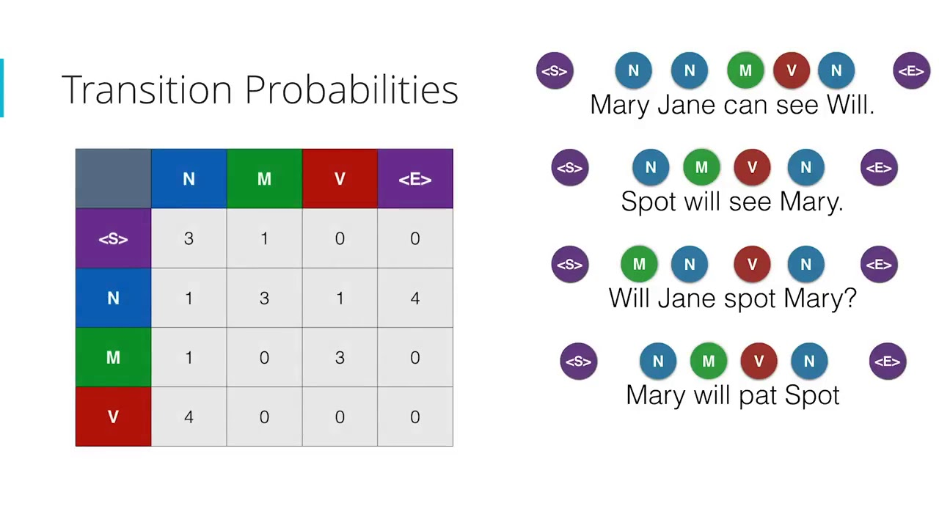
Transition Counts

Slide 6
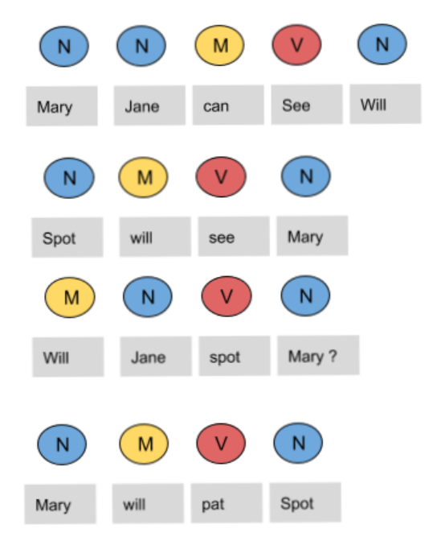
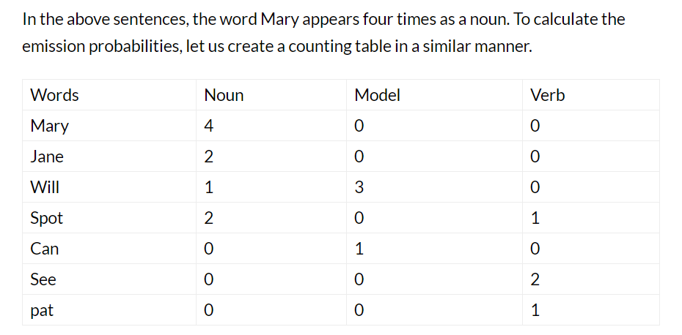
Emission Counts

Slide 7
MODELLING
Input - a text file,a set of tags
Output - Most probable tag for each word in the text file
Modelling of given information as a markov model:
A set of states : {S1,S2…..Sn} - A set of tags- Noun,Verb..
A set of observations : {O1,O2….Om} - A set of all words in the text file
A sequence of length T - A particular line in the text file.
Transition probability matrix - Probability of a tag after another-NOT AVAILABLE
Emission probability matrix - Probability of a word corresponding to a tag-NOT AVAILABLE

Slide 8
Baum-Welch algorithm
Finds most probable A and B matrices
Starts with randomly initialized A and B matrices.
B(emission matrix)-Probability of a word corresponding to a tag
From this, most probable tag for each word - required output, can be easily produced.

Slide 9
IMPLEMENTATION
There are a few phases for this algorithm, including the initial phase, the forward phase, the backward phase, and the update phase.
The forward and the backward phase form the E-step of the EM algorithm, while the update phase itself is the M-step.
Initial Phase:
In the initial phase, the content of the parameter matrices A, B, π₀ are initialized, and it could be done randomly if there is no prior knowledge about them.

Slide 10
The recursive behavior saves computations by freeing us from looking through the observed data every time.
Forward Phase:
The recursive alpha function defined as the joint probability of the observed data up to time k and the state at time k is calculated.
Backward Phase:
The recursive beta function defined as the conditional probability of the observed data from time k+1 given the state at time k is calculated.

Slide 11
Update Phase:
The update phase is the M-step because few update formulas are derived such that the L.H.S. parameters will best fit the expected hidden states given the observed data.
The two steps(E & M) are then iterated over and over again until the parameters converged, or until the model has reached some certain accuracy requirement.

Slide 12
Implementation of Baum-Welch Algorithm

Slide 13
TIME COMPLEXITY
The brute-force procedure is generation of all possible state sequences and calculating joint probability of each state sequence. This approach has a time complexity O(T* N^T) where T is the length of sequences and N is number of symbols.
However, the forward-backward algorithm has time complexity O(N^2 *T).

Slide 14
CONCLUSION
Baum-Welch pos tagger was able to provide most probable tag for each word.
Unlike other natural language processing pos taggers, baum-welch taggers don’t need a set of training data, which makes it an useful tool.
Further, to evaluate precision of the model we successfully modified the algorithm to use tokenized data instead of raw text, and calculate the accuracy score using true and predicted tags.

Slide 15
THANK YOU

